Slide 1

Python Sets

Slide 2
Introduction
A set is an unordered collection of items. Every element is unique and must be immutable.
However, the set itself is mutable. We can add or remove items from it.
Sets can be used to perform mathematical set operations like union, intersection, symmetric difference etc

Slide 3
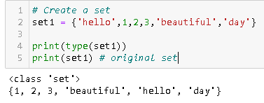
Creating a set
A set is created by placing all the elements inside curly braces {}, separated by comma or by using the built-in function set().
The elements can be of different types (integer, float, tuple, string etc.).
But a set cannot have a mutable element, like list, set or dictionary, as its element

Slide 4
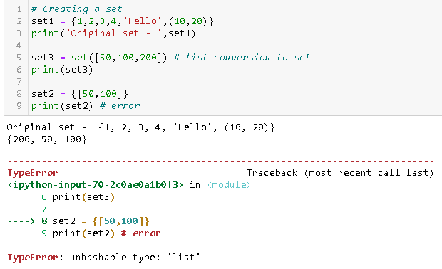
A set can contain elements of different type
A set cannot contain lists
We can convert a list to set using set function

Slide 5
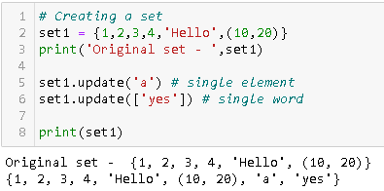
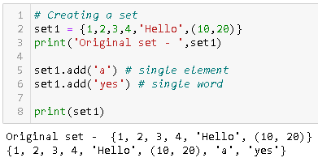
Adding elements to the set
Sets are mutable. But since they are unordered, indexing have no meaning.
We cannot access or change an element of set using indexing or slicing.
We can add single element using the add() method and multiple elements using the update() method.
The update() method can take tuples, lists, strings or other sets as its argument.

Slide 6
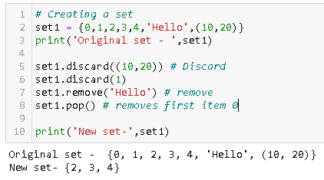
Removing elements from the set
A particular item can be removed from set using methods, discard() and remove().
Using discard() if the item does not exist in the set, it remains unchanged. But remove() will raise an error in such condition.
Pop() function can also be used to remove and return an element from the set, but it removes only the last element of the set.

Slide 7
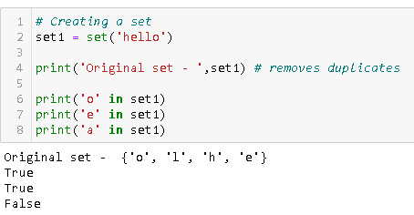
Set Membership
We can test if an item exists in a set or not, using the in operator.

Slide 8
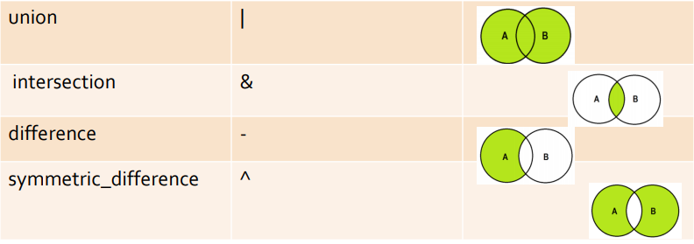
Set Operations
Sets can be used to carry out mathematical set operations like union, intersection, difference and symmetric difference.
We can do this with operators or methods.

Slide 9
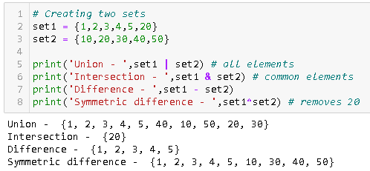
Operations (contd.)

Slide 10
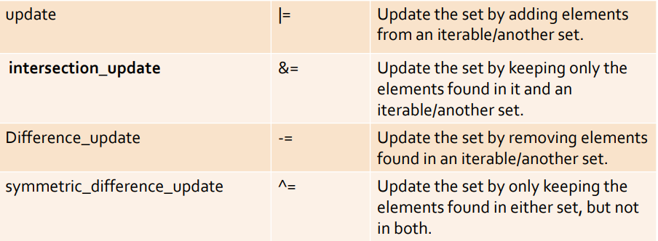
Mutation Operations
We have seen the applications of union, intersection, difference and symmetric difference operations, but these operations do not make any changes or mutations to the set.
We can use the following operations to create mutations to a set:

Slide 11
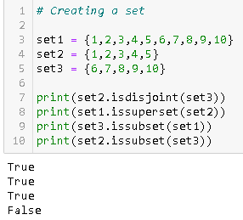
Isdisjoint–This method will return True if two set have a null intersection
Issubset –This method reports whether another set contains this set
Issuperset –This method will report whether this set contains another set

